Slide 1

ONLINE EXAM PORTAL

Slide 2

Vijayalakshmi M(52076408)
Yarram Srilatha(52071423)
Kiran Basanagouda Patil(52073110)
Shastri Ashvini Vilas(52072297)

Slide 3
CONTENT:
Introduction
Objective
Problem Statement
Use Case Model
Tools and Technologies
Screenshots
Conclusion

Slide 4
INTRODUCTION:
Online exam portal is a web based application which will considerably reduce the time to give the exam. It avoids the student’s need to go to the physical destination and publishes the result instantly. This portal also helps in evaluating the exams efficiently. This portal is advantageous for both students and teachers.

Slide 5
OBJECTIVE
The main purpose of the system is to efficiently evaluate through a fully automated system which in turn saves a lot of time.
This system avoids the candidates to go to the physical destination for attending the examinations. The candidates can simply login and take exams at their convenient places.
The system calculates the scores accurately and provides results instantly.
It removes the human errors that may occur during the manual checking.

Slide 6
PROBLEM STATEMENT:
The candidates must travel long distance to attend examinations.
The results may take longer time to get published and may not be accurate.
The physical examinations are time consuming as well as big-budget.

Slide 7
MODULES AND SERVICES:
MODULES:
User
Admin
II. SERVICES:
User -> Home, View Categories,View Quizzes,Logout
Admin ->Home,Update categories,Update quizzes

Slide 8
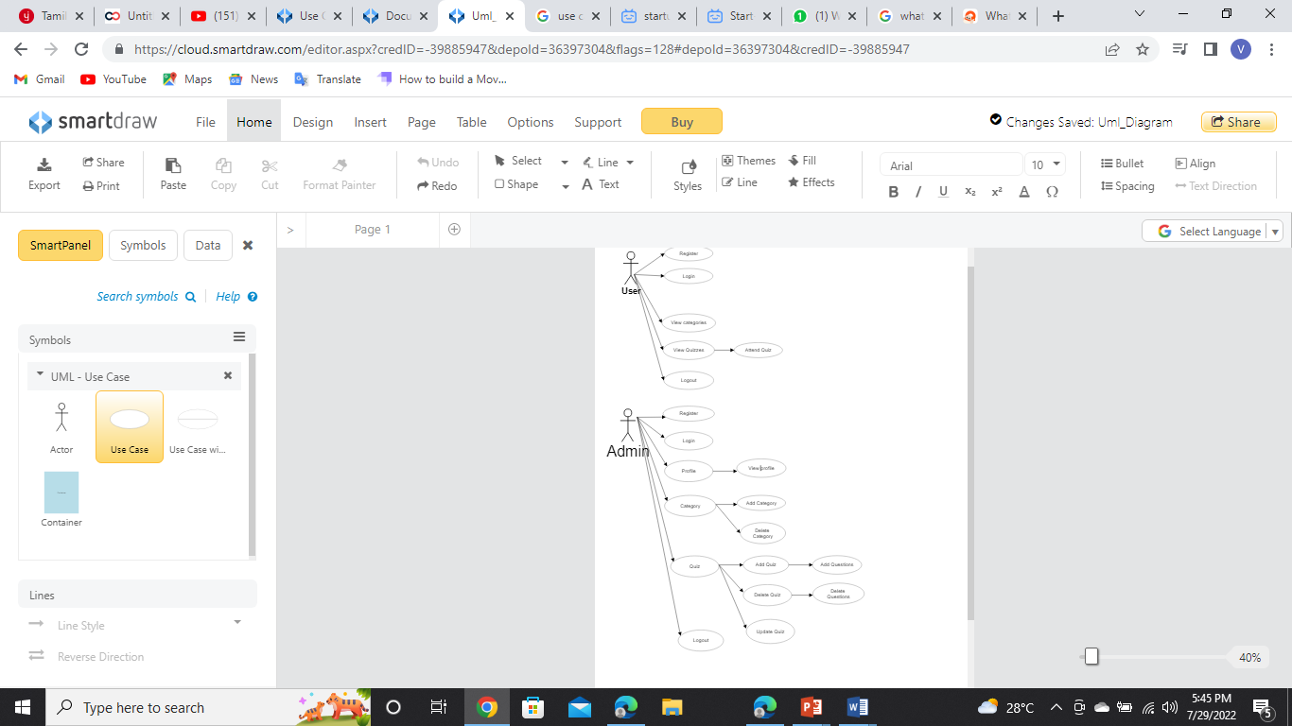
USE CASE DIAGRAM

Slide 9
TOOLS AND TECHNOLOGIES:
JDK 1.8
Spring Boot
Angular
SQL
HTML, CSS, Java script
SOFTWARE REQUIRED:
Eclipse IDE
VSCode
Oracle

Slide 10
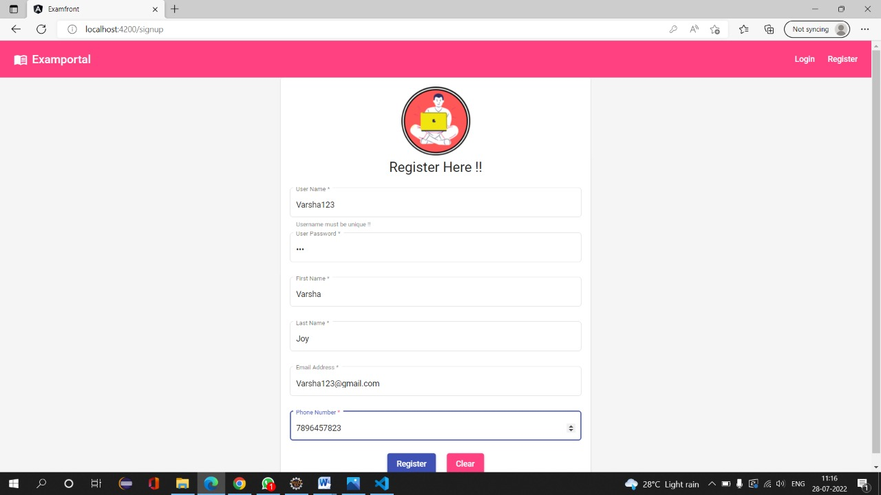

Slide 11
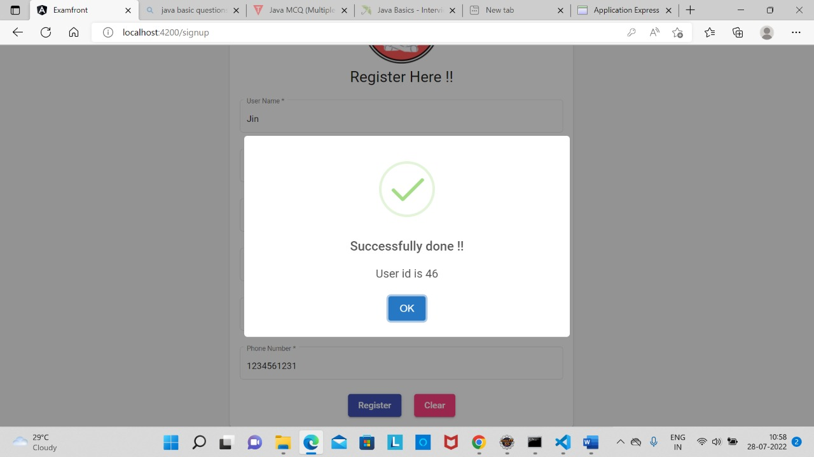

Slide 12
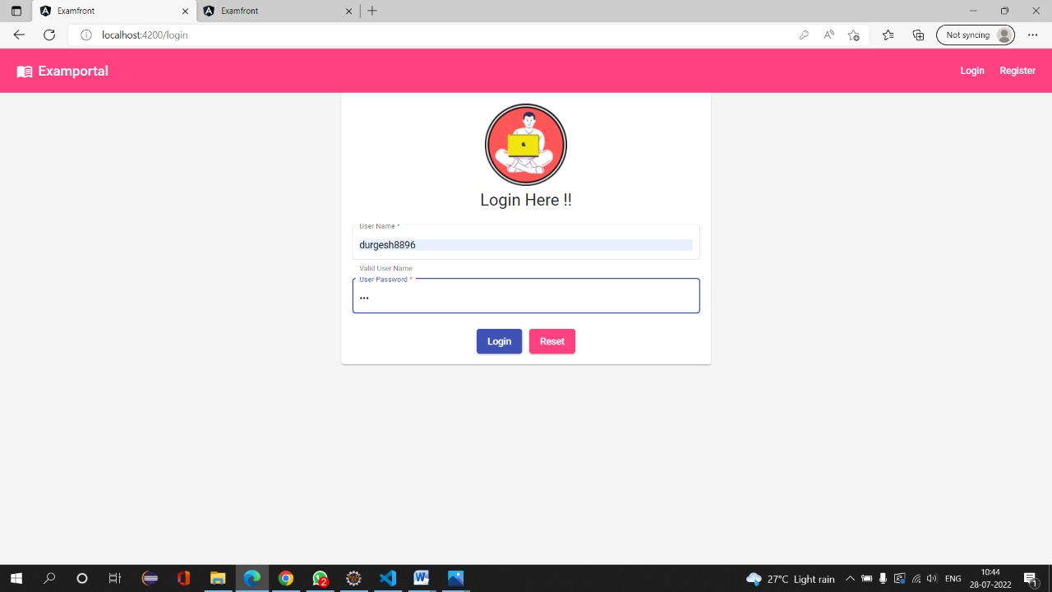

Slide 13
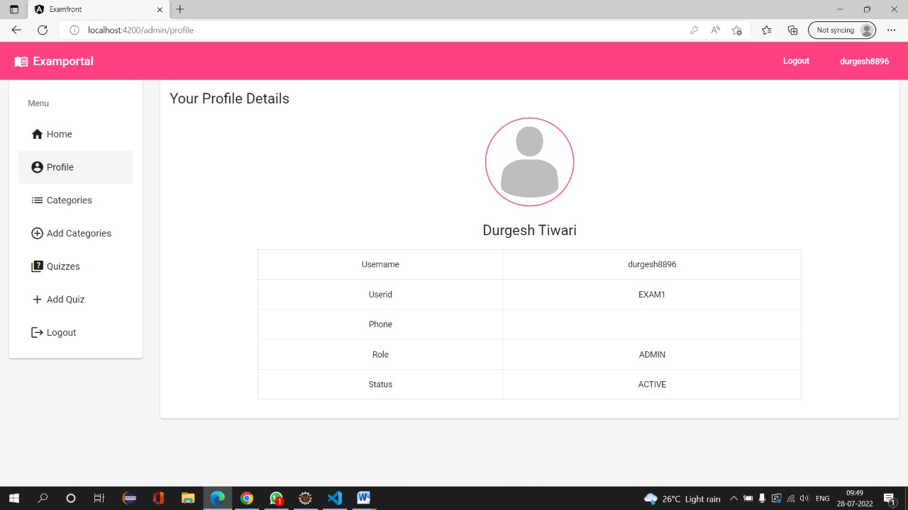

Slide 14
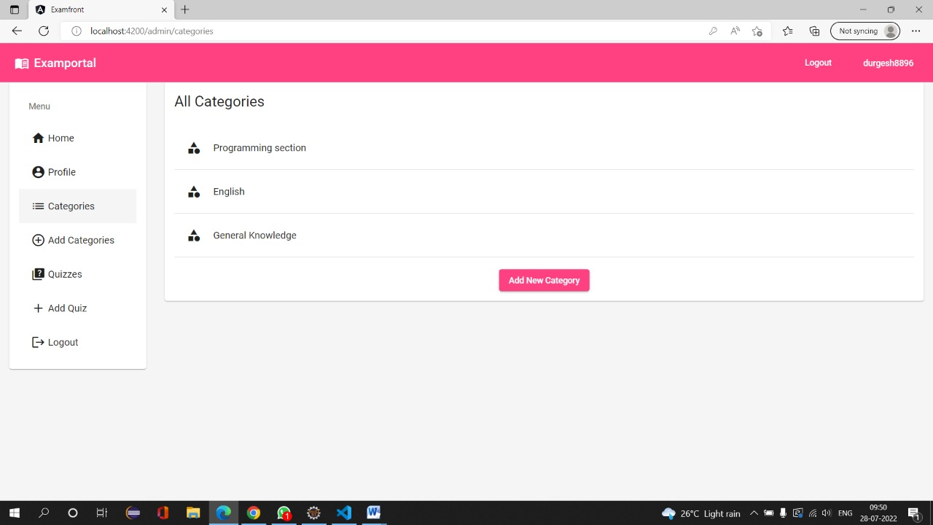

Slide 15
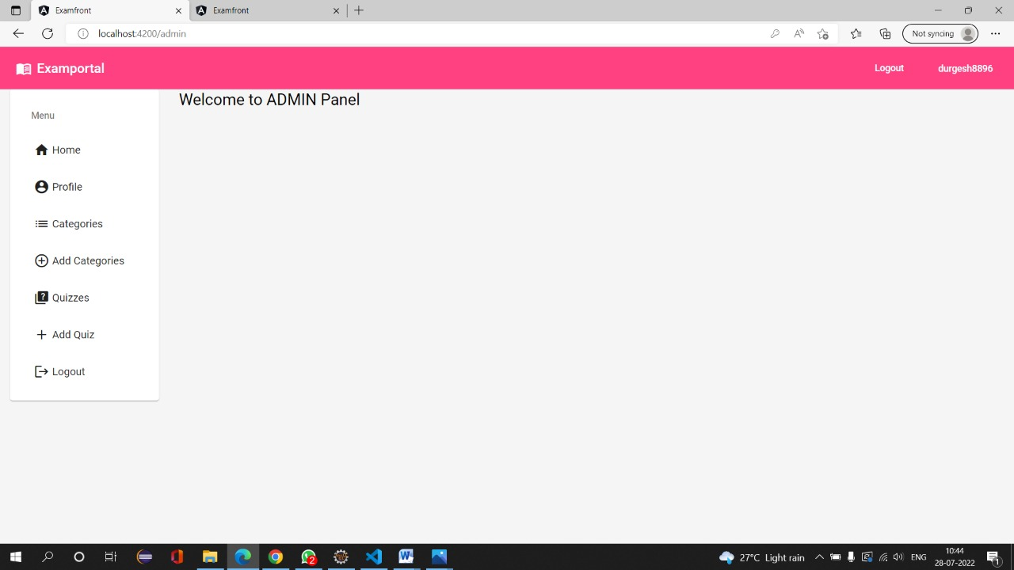

Slide 16
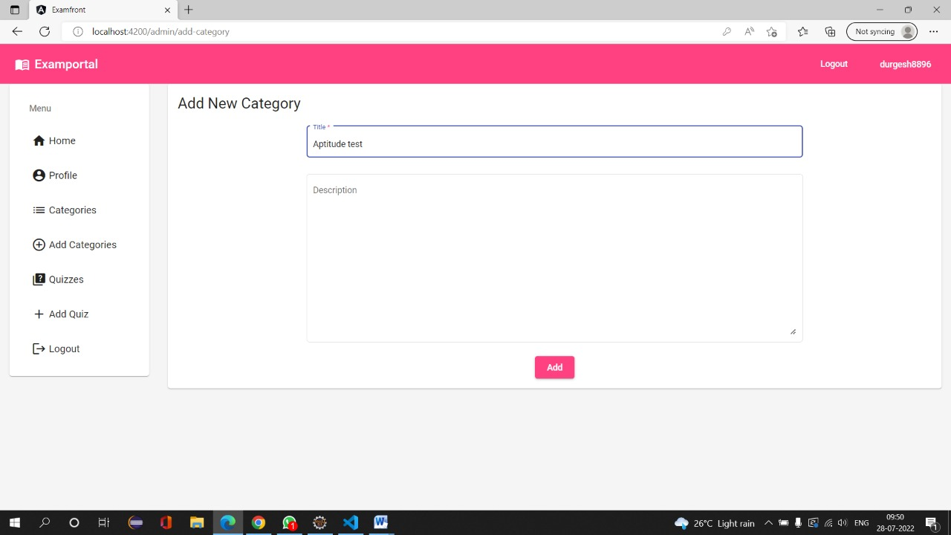

Slide 17
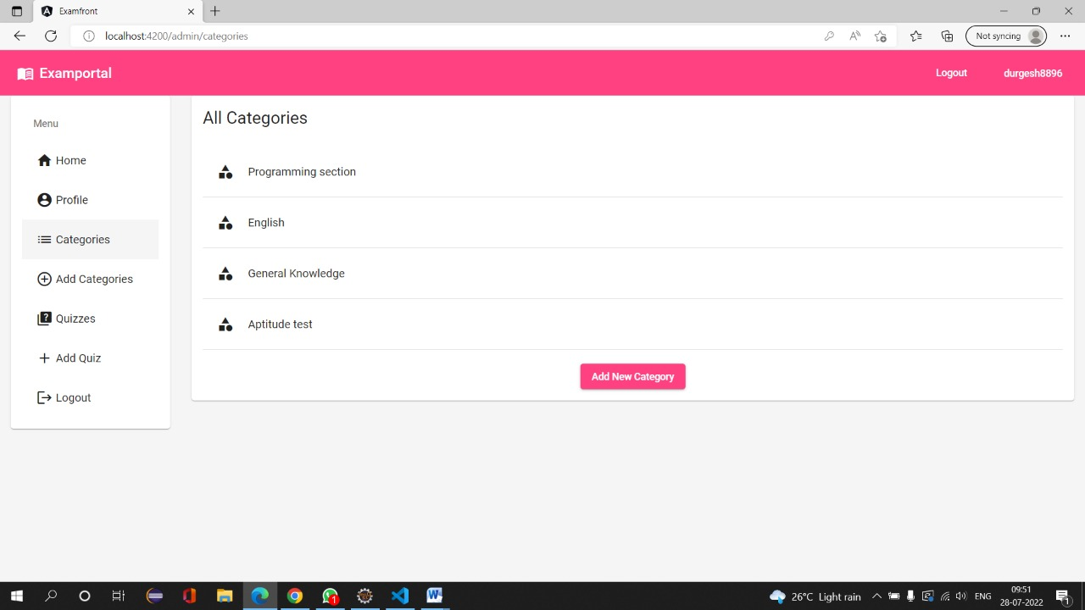

Slide 18
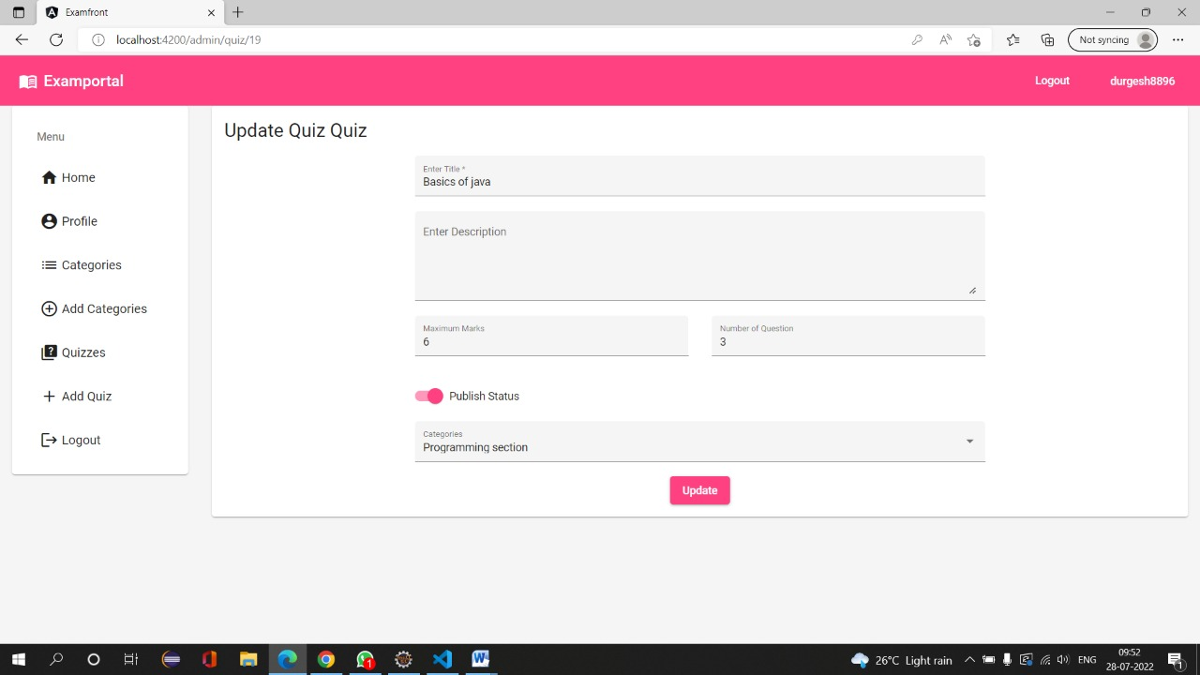

Slide 19
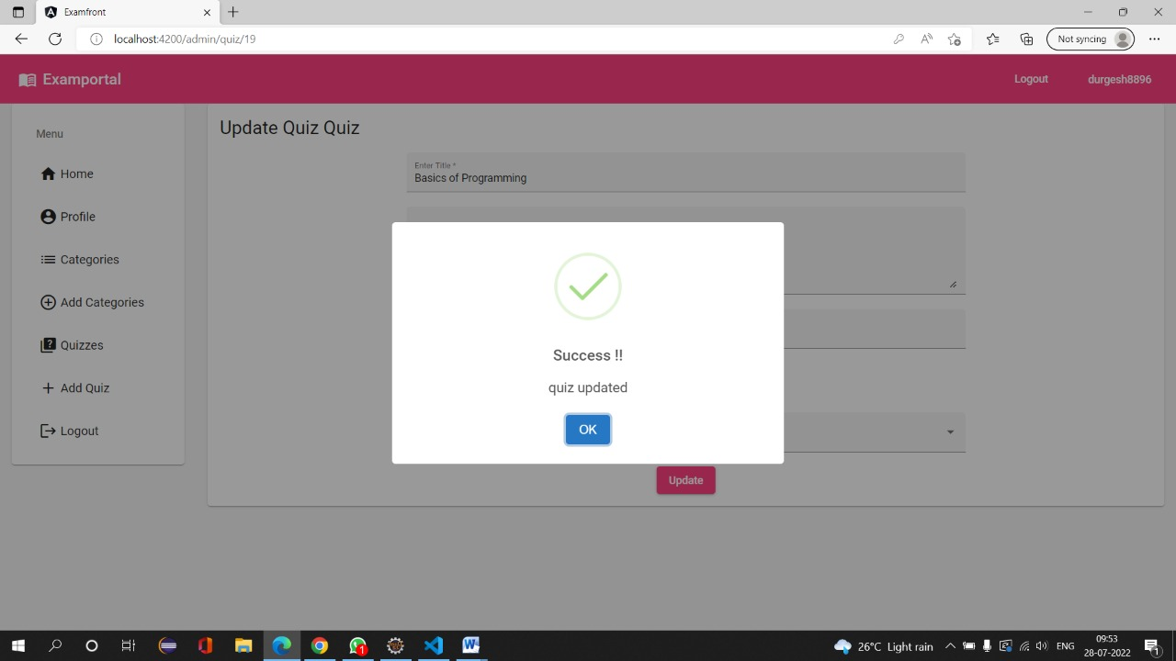

Slide 20
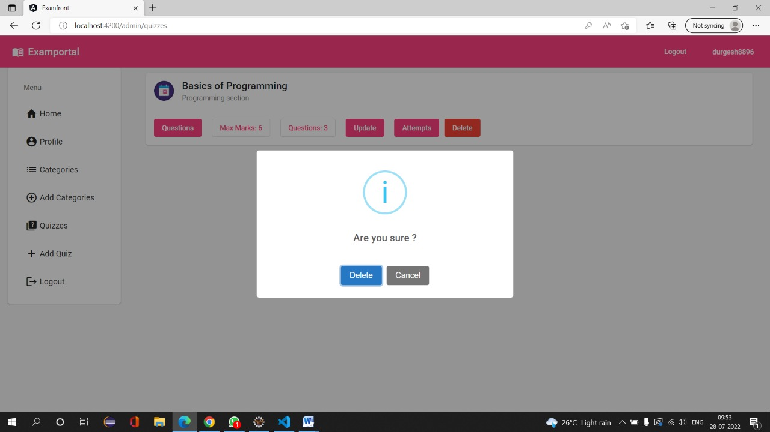

Slide 21
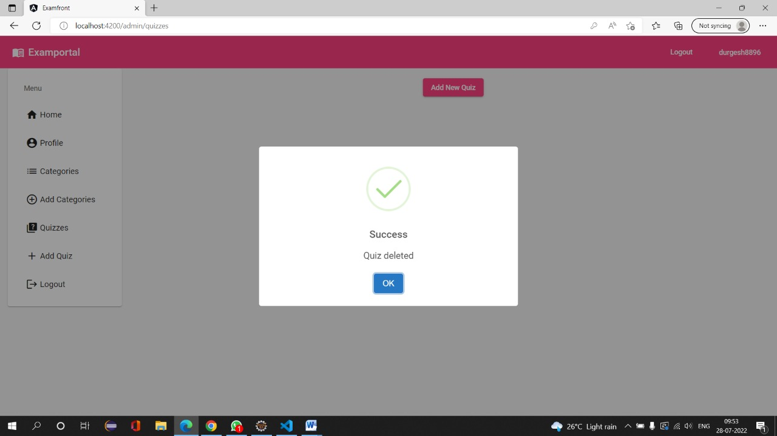

Slide 22
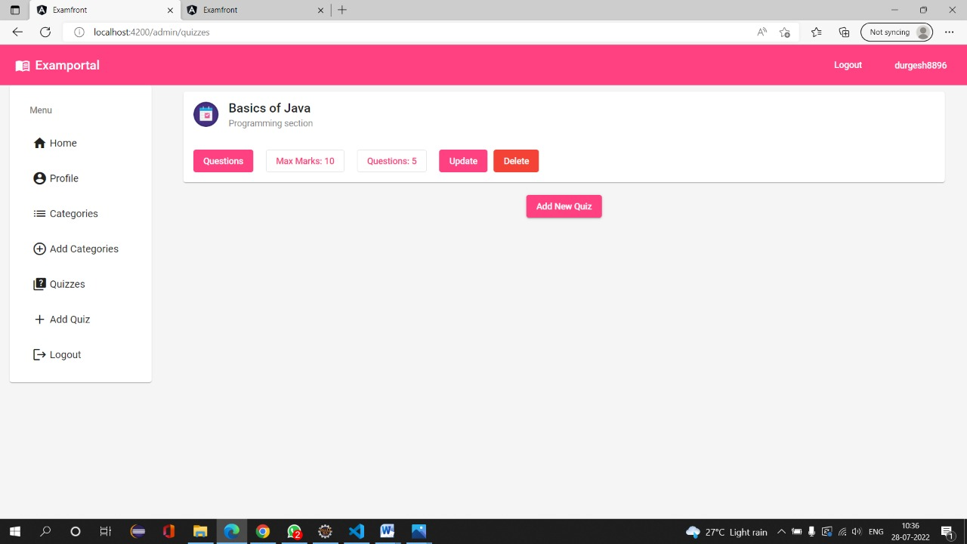

Slide 23
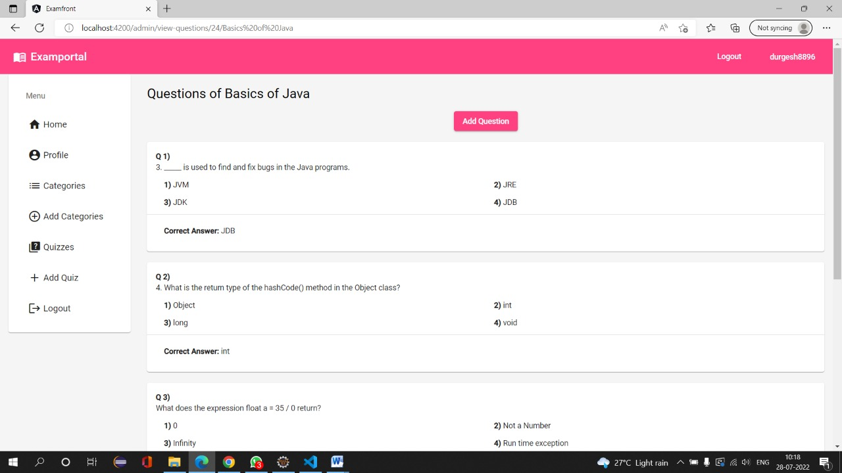

Slide 24
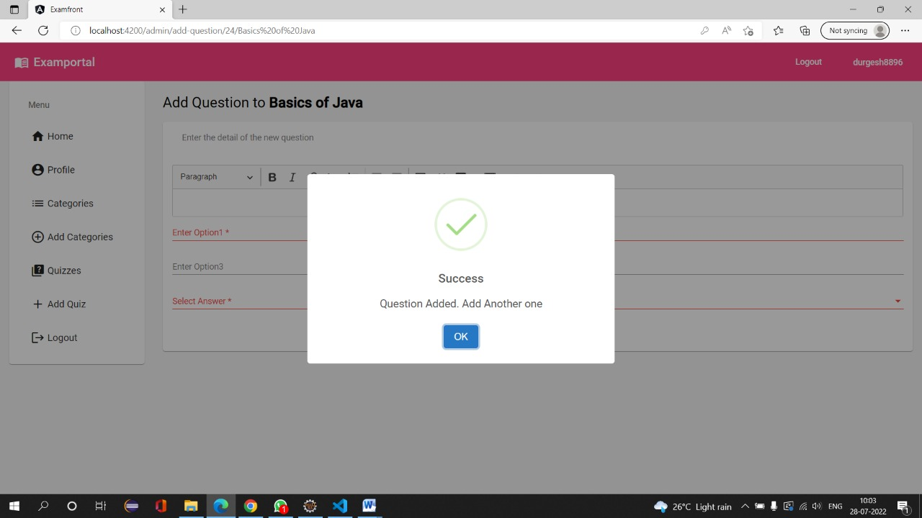

Slide 25
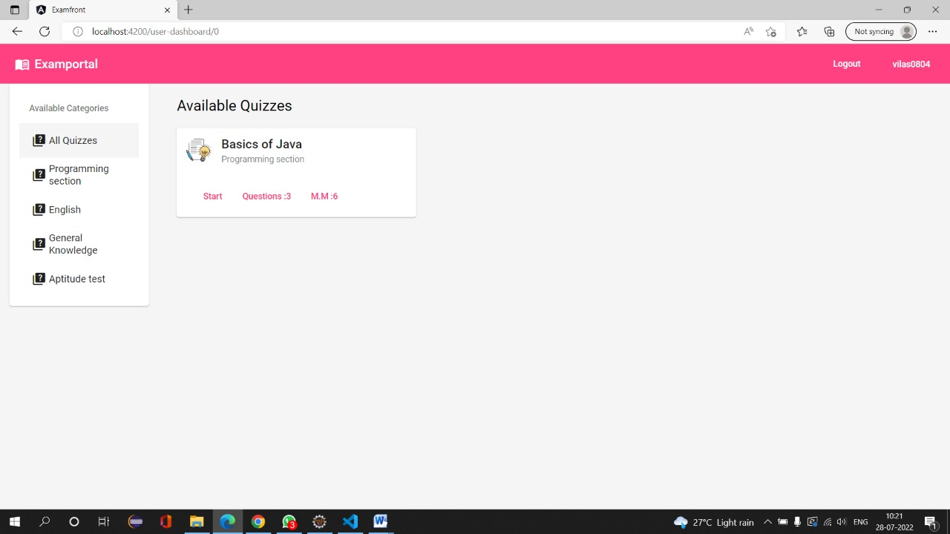

Slide 26
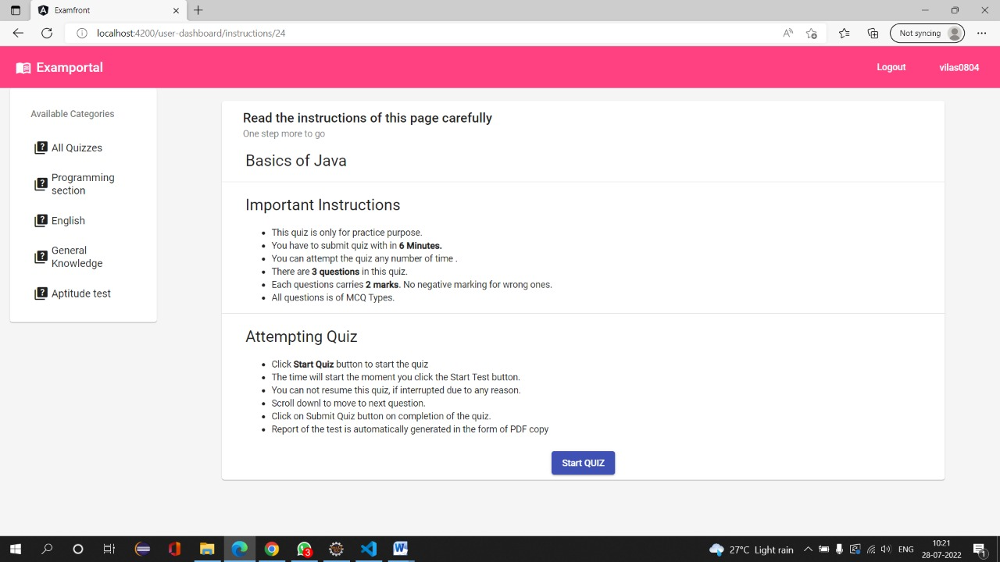

Slide 27
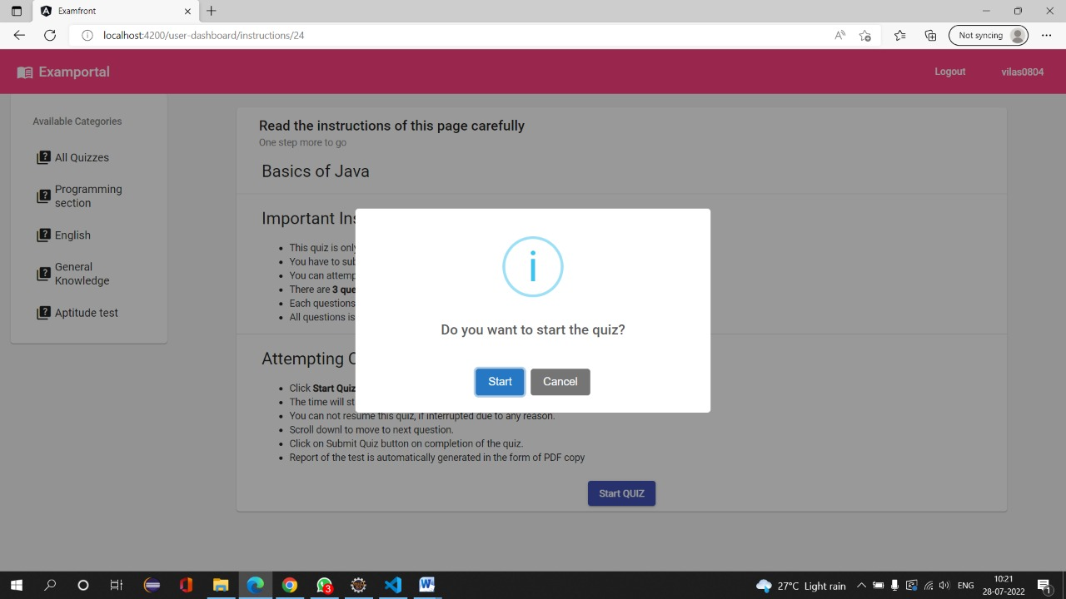

Slide 28
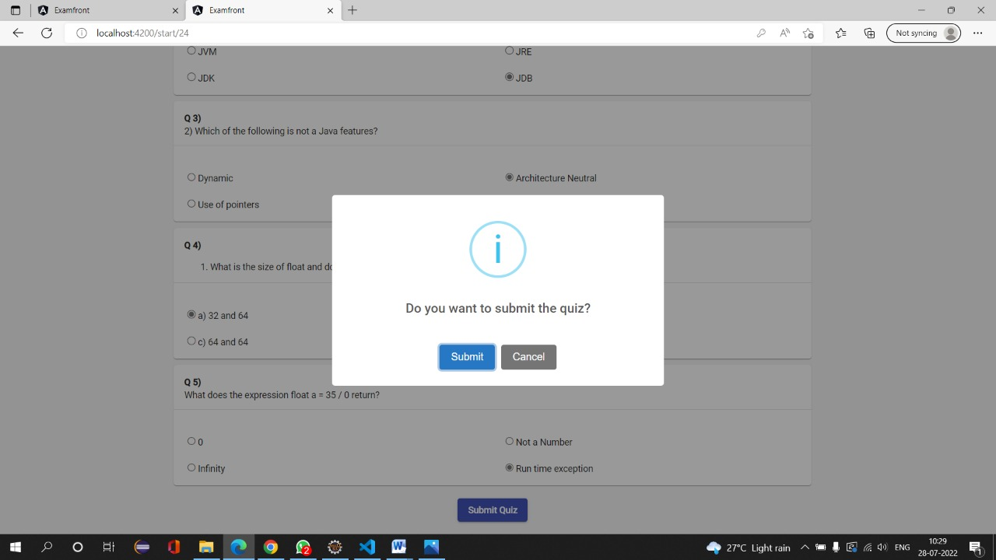

Slide 29
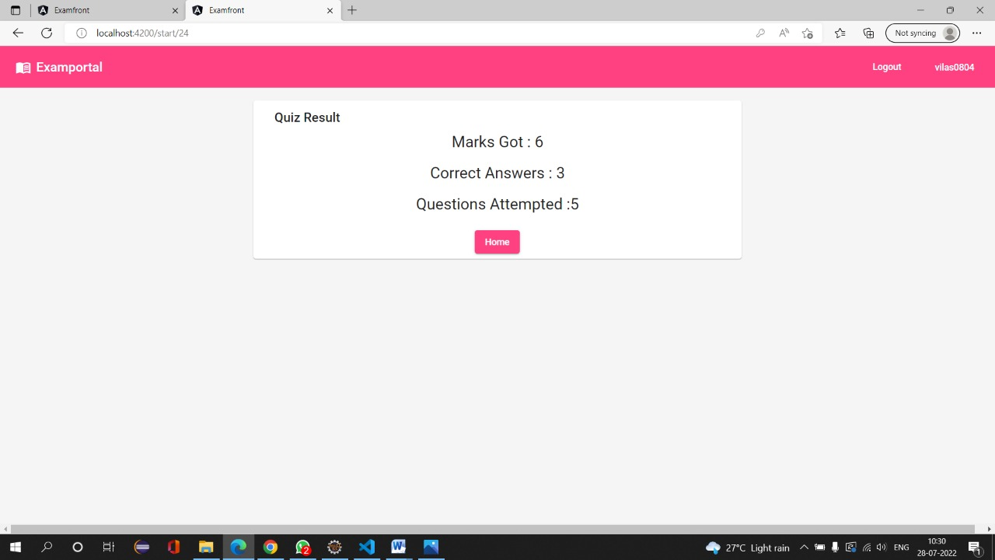

Slide 30
CONCLUSION
Thus this system will be helpful in taking exams at candidate’s feasible places. Also this reduces manual errors as well as time consumption. This system provides paperless examination.

